Slide 1
Introduction to Azure landing zones

Slide 2
Agenda
Introduction to CAF & Ready overview
Operating Models
Azure Landing zones overview
Development Velocity
Implementation options
Partner landing zone

Slide 3
Overview: Microsoft Cloud Adoption Framework for Azure

Slide 4
Microsoft Cloud Adoption Framework for Azure
Proven business and technical guidance to help customers create and implement the business and technology strategies necessary to succeed in the cloud
Define strategy
Define business justification and expected outcomes
Plan
Align actionable cloud adoption plan to business outcomes
Ready
Prepare people, process and environment for change
Adopt
Migrate or Innovate
Implement desired changes across IT and business processes
Govern
Comply, control and secure
Manage
Operate and optimize
Notes:
<Key point>: Cloud Adoption Framework—modular phases of adoption.
As your organization evolves, the Cloud Adoption Framework adapts to your business needs.
Each module in the diagram is an iterative phase that advances your business through the complete lifecycle of cloud adoption.
Customers can choose the phase best-suited to their degree of cloud adoption maturity. The Cloud Adoption Framework offers a guiding methodology to cloud adoption, with specific approaches to overcoming common blockers to cloud adoption in each module, such as “Define Strategy,” “Plan,”, etc.
The Cloud Adoption Framework offers the enterprise a modular framework of how to incrementally onboard to the cloud.
Cloud adoption shifts how companies obtain, make use of, and lock down their technology resources.
And—this kind of modular framework flips the model of how enterprises operate:
Transitions organizations to need-based consumption of technology resources
Change from cap-ex (capital expenditure) to op-ex (operating expenditure) model
Cloud model assumes security, governance, cost-optimization, and hybrid cloud by default
Develop a future-ready workforce—developing and deploying cloud skill readiness organization-wide
As an organization progress through the Cloud Adoption Framework, what are the main goals of each methodology of “Define Strategy,” “Plan,” you can focus efforts on?
<Transition>: Now that we have taken look at the phases and modular approach, lets look at about some common business blockers that the Cloud Adoption Framework can help you resolve.

Slide 5
Microsoft Cloud Adoption Framework for Azure
Templates
People
Process
Technology
Best practices
Documentation
Tools
Achieve balance
Align—business, people and technology strategy.
Achieve—business goals with actionable, efficient, and comprehensive guidance.
Deliver—fast results with control and stability.
Notes:
Started with notion that the value of cloud services (speed, agility, innovation, cost, security) is often negatively impacted by existing/legacy enterprise IT processes and practices (Legacy doesn’t work)

Slide 6
Microsoft Cloud Adoption Framework for Azure
Proven business and technical guidance to help customers create and implement the business and technology strategies necessary to succeed in the cloud
Define strategy
Define business justification and expected outcomes
Plan
Align actionable cloud adoption plan to business outcomes
Ready
Prepare people, process and environment for change
Adopt
Migrate or Innovate
Implement desired changes across IT and business processes
Govern
Comply, control and secure
Manage
Operate and optimize
Notes:
<Key point>: Cloud Adoption Framework—modular phases of adoption. When creating your landing zones, you are in the step prior to deployment (adoption) … as we have said, getting ready to deploy your workloads.
As your organization evolves, the Cloud Adoption Framework adapts to your business needs.
Each module in the diagram is an iterative phase that advances your business through the complete lifecycle of cloud adoption.
Customers can choose the phase best-suited to their degree of cloud adoption maturity. The Cloud Adoption Framework offers a guiding methodology to cloud adoption, with specific approaches to overcoming common blockers to cloud adoption in each module, such as “Define Strategy,” “Plan,”, etc.
The Cloud Adoption Framework offers the enterprise a modular framework of how to incrementally onboard to the cloud.
Cloud adoption shifts how companies obtain, make use of, and lock down their technology resources.
And—this kind of modular framework flips the model of how enterprises operate:
Transitions organizations to need-based consumption of technology resources
Change from cap-ex (capital expenditure) to op-ex (operating expenditure) model
Cloud model assumes security, governance, cost-optimization, and hybrid cloud by default
Develop a future-ready workforce—developing and deploying cloud skill readiness organization-wide
As an organization progress through the Cloud Adoption Framework, what are the main goals of each methodology of “Define Strategy,” “Plan,” you can focus efforts on?
<Transition>: Now that we have taken look at the phases and modular approach, lets look at about some common business blockers that the Cloud Adoption Framework can help you resolve.

Slide 7


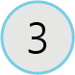
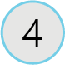
Cloud Adoption Framework: Ready
The ‘Ready’ module establishes a cloud foundation or adoption target that can provide hosting for any adoption efforts.
Azure setup guide
Azure setup guidance on the tools and approaches you need to create a landing zone
First landing zone
Choose the most appropriate landing zone option to establish a code-based starting point for your environment
Expand the landing zone
Meet the platform considerations of your cloud adoption plan by expanding your landing zone
Best practices
Validate landing zone modifications against best practices
Notes:
Ref: https://docs.microsoft.com/en-us/azure/cloud-adoption-framework/ready/
To get you Ready to deploy your first workloads on Azure, there are four exercises that help guide you.

Slide 8
Azure landing zones

Slide 9





The value of creating cloud-ready environments
Aligned to business priorities
Cloud-design considerations
Adapted for cloud operating model
Ready for cloud applications
Adaptable to grow and expand
Compliant
Agile
Cutting-edge innovation
Secure
Notes:
Customer challenges when setting up cloud environments
Architecture complexity
Many customers simply replicate their existing on-premises design and architecture in Azure. However, the mismatch between on-premises infrastructure and cloud-design considerations creates dissonance and friction with respect to defining architectures and standards for their migration to the cloud.
Operating compatibility
Existing approaches and functions for the traditional delivery and management of IT services are not compatible with the Azure platform and cloud operating models. As many customers simply replicate existing on-premises technologies and processes to Azure, customers are struggling to define and therefore transform their operating model to manage and support large-scale cloud infrastructure.
Lack of trust and desire for control
The absence of a precise and detailed cloud architecture that is compliant with their requirements, and the lack of a well-defined operating model to support such a platform, leads IT not to trust Azure and instead strive to maintain full control. This often involves building ‘walls’ and complicated processes which ultimately get in the way of business lines adopting Azure.

Slide 10
Azure landing zones
Azure landing zones help customers set up their Azure environment for scale, security, governance, networking, and identity.
Azure landing zones:
Enable migrations and net new apps
Consider all platform resources
Don't differentiate between IaaS or PaaS

Slide 11

Azure Landing Zones | Design Areas
Enterprise Enrollment
Identity
Resource Organization
Network Topology & Connectivity
Business Continuity & Disaster Recovery
Governance disciplines
Deployment options
Operations baseline
Notes:
There are different Azure landing zone implementation options and each of them provide a different deployment approach. Before choosing an implementation option, let’s talk about the design areas for Azure landing zones.
Talking points ---
Enterprise enrollment: IF you are making a commitment to use a specific amount of Azure, you'll want to consider how your EA enrollment is configured & ensure your Azure AD tenant is aligned.
Identity: Are you using your existing Azure AD tenant from Office 365 by applying RBAC? Or do you have deeper security requirements that require more considerations?
Resource organization: Get a jump on cloud governance by preparing for proper resource organization early. This includes things like naming, tagging, subscriptions, resource groups, and management groups. Good design now will make portfolio governance easier later
Network Topology & Connectivity: are the two must have considerations. Until you understand how things connect to in the cloud & how people gain access, you can't really use the cloud
Business continuity and disaster recovery - BCDR provides the foundation for reliability and rapid recovery. BCDR isn't really a design area, its a discipline under CAF Manage. i don't generally talk to it as a pillar, even though its on the design areas page. if anything just a brief mention of it during the Operations baseline talking point.
Governance disciplines: Begin including the governance disciplines in every landing zone to get an early start on governance, security baseline, and compliance policies.
Deployment options: Azure landing zones provide a variety of deployment options to fit your operating model
Operations Baseline: Get a jump start on operations management (CAF Manage) by preparing each landing zone for visibility, operational compliance, and protect/recover processes.

Slide 12
Start with enterprise scale
Cloud Platform
Cloud Adoption
(Migrate or Innovate)
First workload
First 10* workload
First prod workloads
100+ workloads
Implement Enterprise Scale
The reference implementations of CAF Enterprise Scale provide a rapid implementation option, aligned to an Enterprise Operations model using cloud native security, governance, and operations management tools.

Slide 13
Start small & expand
First workload
First 10* workload
First prod workloads
100+ workloads
Cloud Adoption
(Migrate or Innovate)
Start Small landing zones
Connected environments
Secure landing zones
Shared services model
CCoE and operating model
Cloud Platform
The CAF Start small blueprints initiate a parallel development path. As cloud adoption expands, Central IT or CCoE teams expand the cloud platform to support the adoption plan.

Slide 14
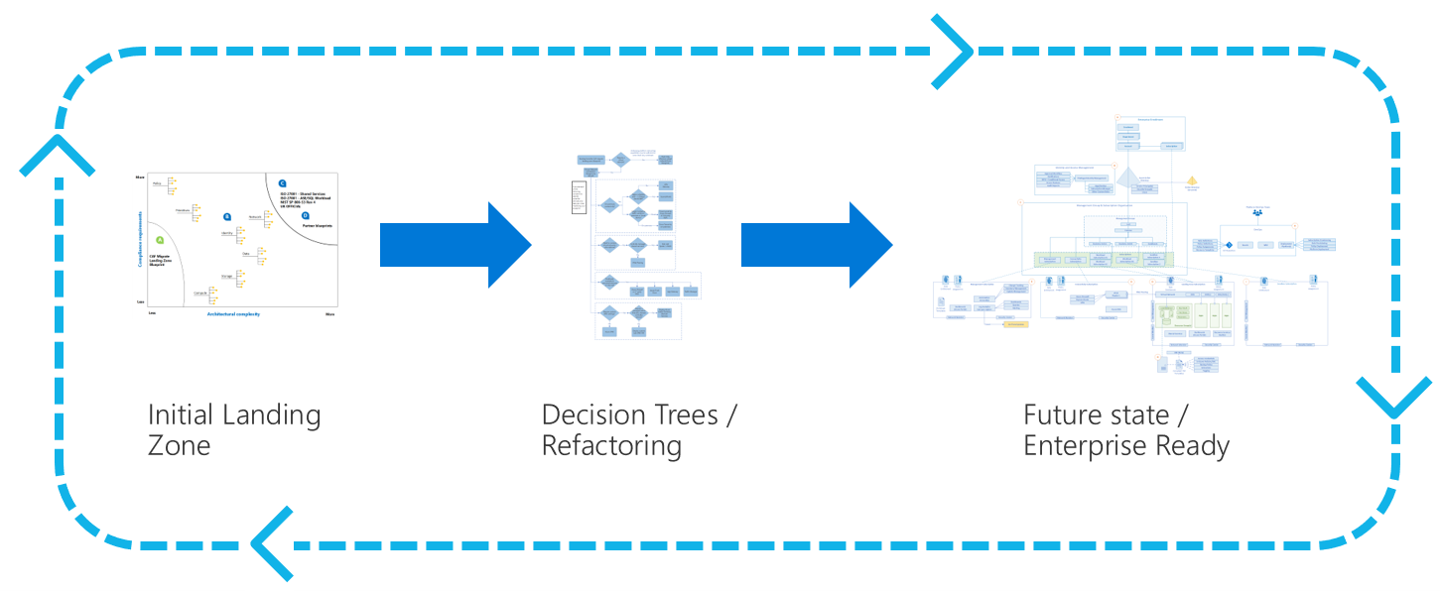
Refactoring landing zones
Since landing zone infrastructure is defined in code, it can be refactored similar to any other codebase. Refactoring is the process of modifying or restructuring source code to optimize the output of that code without changing its purpose or core function.
Notes:
Ref: https://docs.microsoft.com/en-us/azure/cloud-adoption-framework/ready/landing-zone/refactor
The Ready methodology uses refactoring to accelerate migration and remove common blockers (covered in slides 18-19).

Slide 15
Operating Models

Slide 16
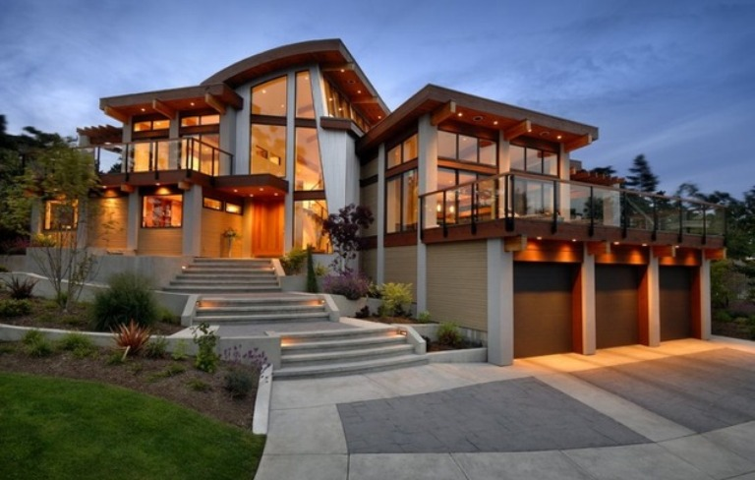
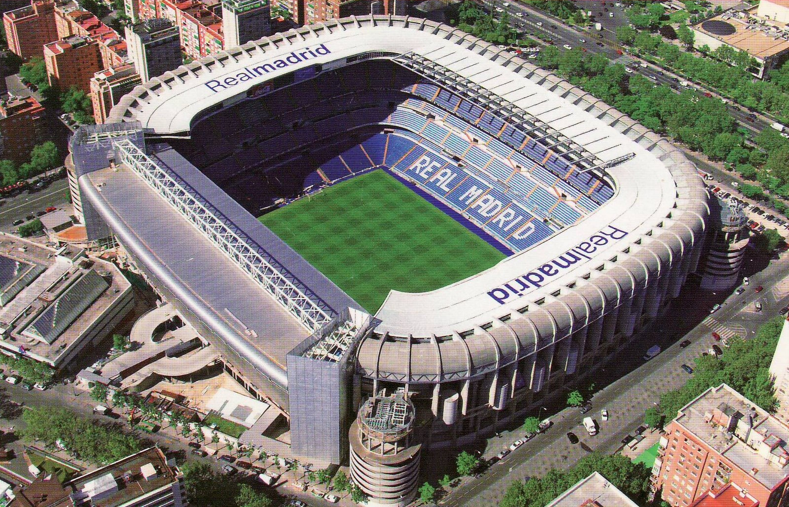

What are you going to build? Your foundation is created to serve a specific purpose
A house
A stadium
A bridge

Slide 17
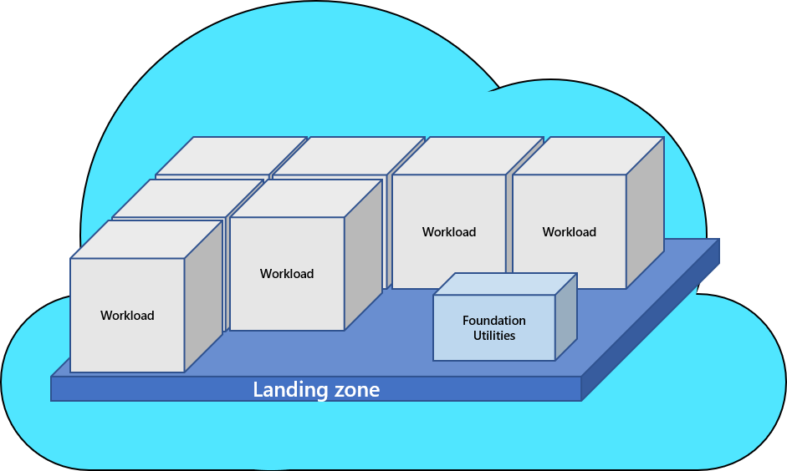
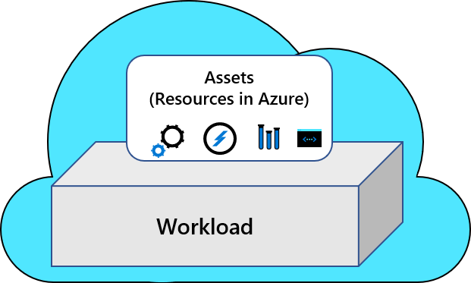
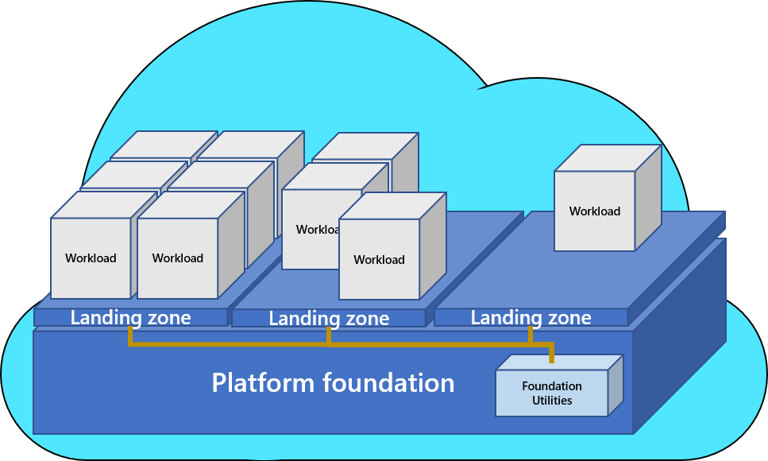
Foundations in the cloud

Slide 18
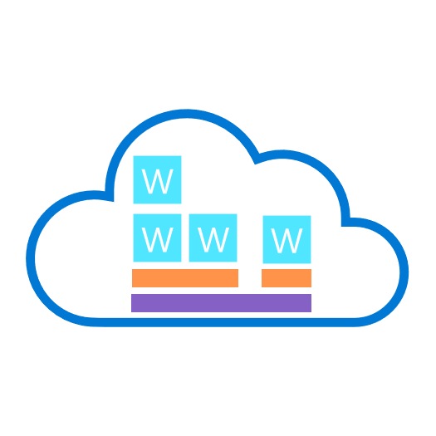





Your foundation should align to your desire Cloud Operating Model
W
Distributed Operations
W
W
W
Enterprise Operations
W
W
W
Environmental complexity
Central Operations
W
W
Workload
Decentralized Operations
Landing Zones
Platform Foundation
Notes:
Remember when I was talking about what you are going to build, and how important is to know that so you have the right foundation.
Maturity on cloud adoption and complexity grows as the cloud operating model gets more complex and align to that the landing zones grows in complexity.
Talking points
Workload operations → Fully decentralized → focus on WAF guidance
Central operation → Central IT services → start small and expand (CAF Migration/Foundation blueprints or Terraform)
Portfolio operations → Cloud Center of Excellence → rich initial implementation (ESLZ)
Global operations → complex operating models → combination

Slide 19
Find the closest model to your needs
W
W
W
W
W
W
W
W
Decentralized Operations
Central Operations
Enterprise Operations
Distributed Operations
Which motivation is your highest strategic priority?
Innovation
Control
Democratization
Integration
What is the scope of your portfolio?
Workload
Landing zones
Cloud platform
Complex portfolio
Who’s accountable for governance, security, and operations decisions?
Workload Teams
Central IT
Cloud Center of Excellence
Mix of all three or unknown
Notes:
Remember when I was talking about what you are going to build, and how important is to know that so you have the right foundation.
Maturity on cloud adoption and complexity grows as the cloud operating model gets more complex and align to that the landing zones grows in complexity.
Talking points
Workload operations → Fully decentralized → focus on WAF guidance
Central operation → Central IT services → start small and expand (CAF Migration/Foundation blueprints or Terraform)
Portfolio operations → Cloud Center of Excellence → rich initial implementation (ESLZ)
Global operations → complex operating models → combination

Slide 20
Implementation options

Slide 21



Key Challenges
Architecture Complexity: Customers lack the required level of understanding and experience on Azure. The mismatch between on-premises infrastructure and cloud-design considerations creates dissonance and friction with respect to defining architectures and standards for their migration to the cloud. They are struggling with the translation of their requirements to Azure concepts, capabilities, constructs and security model.
Operating Compatibility: Existing approaches and functions for the traditional delivery and management of IT services are not compatible with the Azure platform and cloud operating models. When combined with a lack of skills and experience, customers are struggling to define and therefore transform their operating model to manage and support large-scale cloud infrastructure.
Lack of Trust and Desire for Control: The absence of a precise and detailed cloud architecture that is compliant with their requirements, and the lack of a well-defined operating model to support such a platform, leads IT not to trust Azure and instead strive to maintain full control. This often involves building ‘walls’ and complicated processes which ultimately get in the way of business lines adopting Azure.

Slide 22
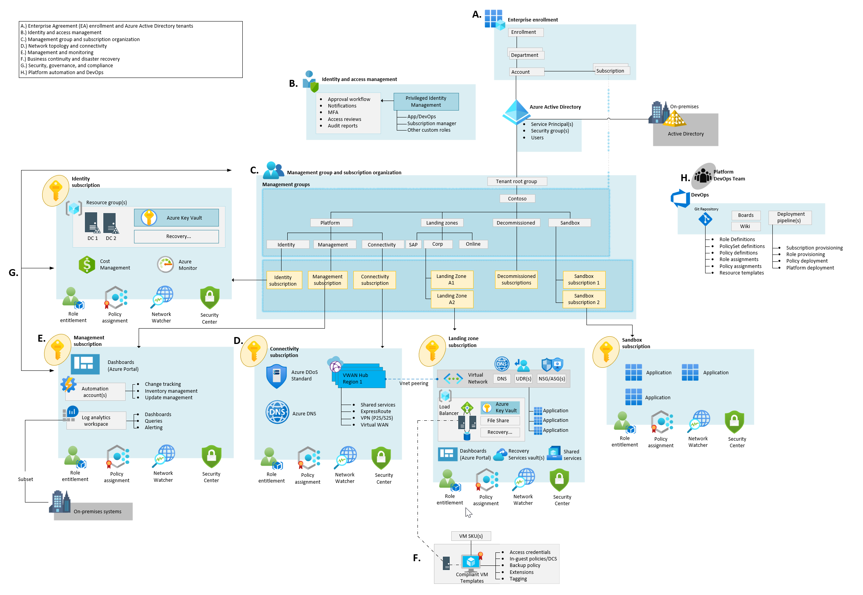
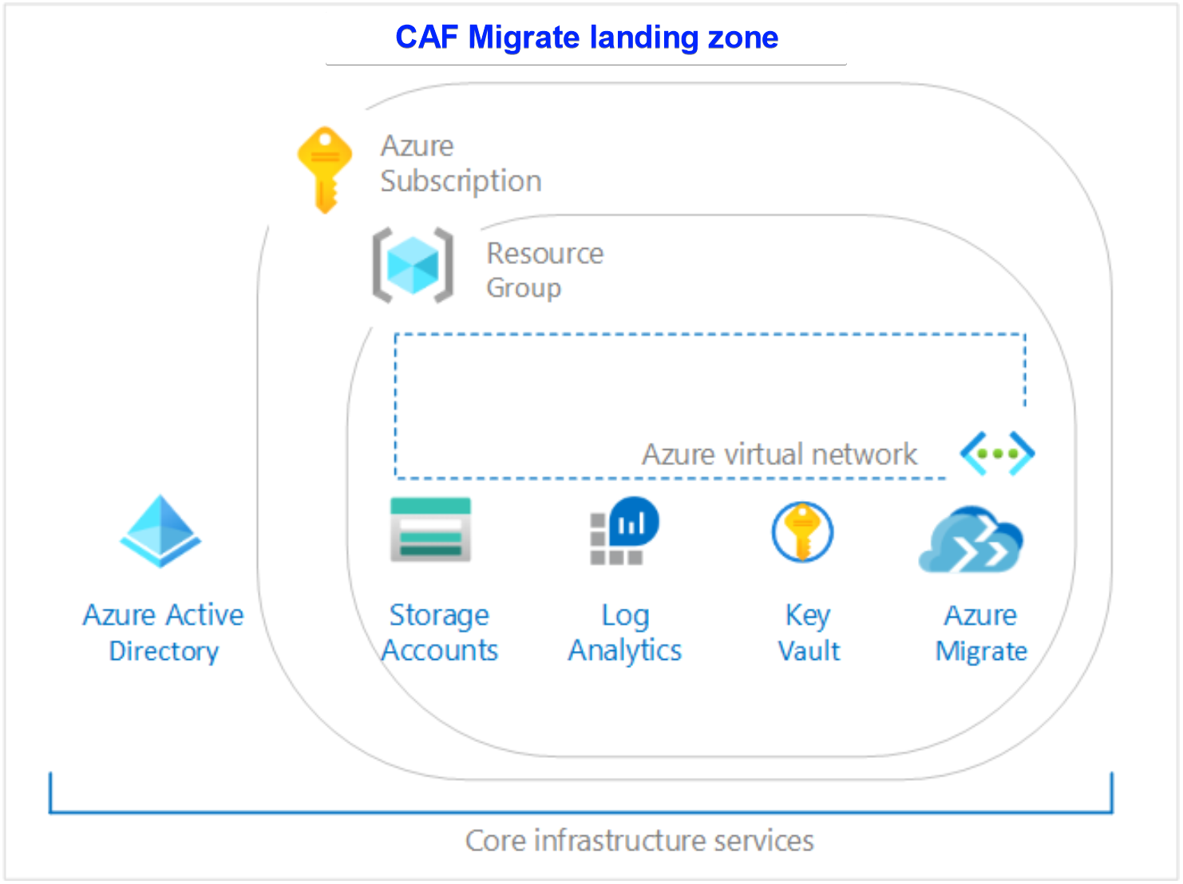
Implementation options – Architecture Deployed
Start small and expand
→ Deploy w/Azure Blueprints + ARM templates
Start with enterprise scale
→ Deploy w/Azure policy + ARM templates
Notes:
Whether you start with enterprise scale or Start small and expand we focus on core technical constructs that must be designed and developed within the context of your requirements to create compliant technical landing zone environments and the conditions for successful Azure adoption.
Identity and access management
Policy management
Management and monitoring
Network topology and connectivity
Shared services infrastructure
DevOps

Slide 23




Start small and expand the landing zone
Expanding your landing zone provides a code-first approach to embedding the following principles into the landing zone and more broadly into your overall cloud environment.
Basic considerations
Refactor landing zone to refine foundational elements
Operations expansions
Add configurations to improve performance, reliability and ops excellence of your workloads
Governance expansions
Add configurations to improve cost, reliability and security of your workloads
Security expansions
Add configurations to improve security of sensitive data and critical systems in your workloads
Notes:
To better align with the methodologies of the Cloud Adoption Framework, the principles above are grouped into actionable landing zone improvements:
Basic considerations: Refactor a landing zone to refine hosting, fundamentals, and other foundational elements.
Operations expansions: Add operations management configurations to improve performance, reliability, and operational excellence.
Governance expansions: Add governance configurations to improve cost, reliability, security, and consistency.
Security expansions: Add security configurations to improve protection of sensitive data and critical systems.

Slide 24
Enterprise Scale landing zones
Enterprise-scale is an architecture approach and reference implementation that enables effective construction and operationalization of landing zones on Azure, at scale and aligned with Azure Roadmap and Cloud Adoption Framework.
Authoritative Provides holistic design decision framework for Azure Platform.
Proven
Based on success of large-scale migration projects at-scale.
Prescriptive Apply this on "Monday Morning" in customer environment.
Enterprise-scale Architecture:
Enterprise-scale design principles: Principles to help/guide you customize the design.
Enterprise-scale design guidelines: Guidelines (decisions and recommendations) for the 8 components of the enterprise-scale architecture
Enterprise-scale Implementation guide: The way you create those things using reference implementation in GitHub and the deployment pipeline
Enterprise-scale reference Implementation:
Enterprise-scale foundation: A reference implementation of shared services containing network, security, identity, governance services required to construct and operationalize an enterprise-scale landing zone
Enterprise-scale landing zone(s): A reference implementation of a workload environment conforming to the enterprise-scale architecture (opinionated way to implement, code)
Notes:
Enterprise-scale comes in two buckets
The Architecture – What must be true? This is our Microsoft opinion on what should be done based on really world work with our strategic customers.
The reference implementation – This is a first partner example on how this could be implemented. You do not have to use this reference implementation if you are following the design guidelines and principles.
During our customer pilots we plan to validate both if possible but he priority in the architecture.

Slide 25
Enterprise-scale Design Principles
Enable Autonomy for Innovation and Transformation
Security and Compliance By-Default
Governance At-Scale with Sustainable Cloud Engineering
Subscription Democratisation
Policy Driven Governance
Single Control and Management Plane
Application Centric and Archetype-Neutral
Azure Native Design and Platform Roadmap Alignment
Notes:
Subscriptions should be used as a unit of management and scale aligned with business needs and priorities.
Azure Policy should be used to provide the “guard-rails” and ensure the continued compliance of the customer platform and applications deployed onto it, whilst also providing application owners sufficient freedom and a secure unhindered path to cloud.
The “North Star” architecture should not consider any abstraction layers such as customer developed portals or tooling and should provide a consistent experience for both AppOps (centrally managed operation teams) and DevOps (dedicated application operation teams).
The “North Star” architecture should focus on application centric migrations and development rather than a pure infrastructure “lift and shift” migration (i.e. movement of virtual machines) and should not differentiate between old/new applications or IaaS/PaaS applications.
The North Star architecture strongly advocates the use of native platform services and capabilities wherever possible, which should be fully aligned with Azure platform roadmaps from the offset to ensure new capabilities are swiftly made available within customer environments.

Slide 26
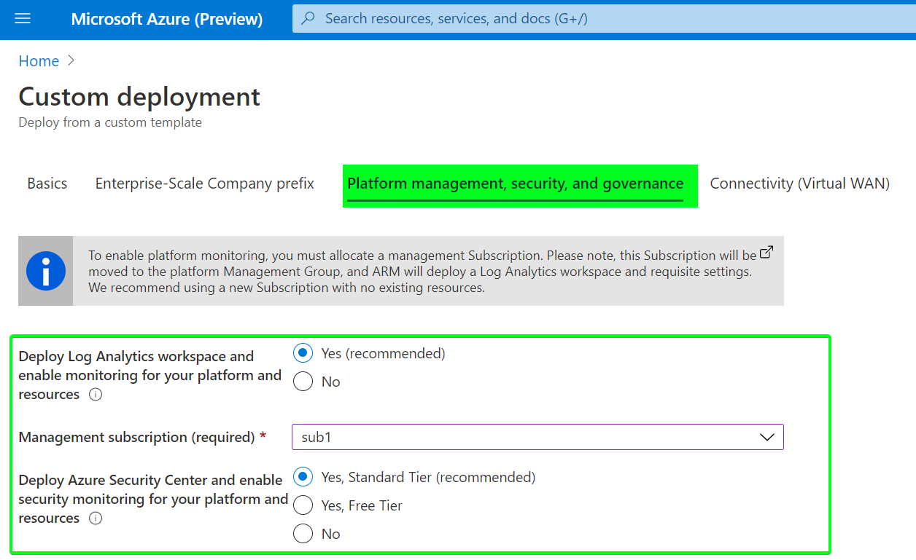
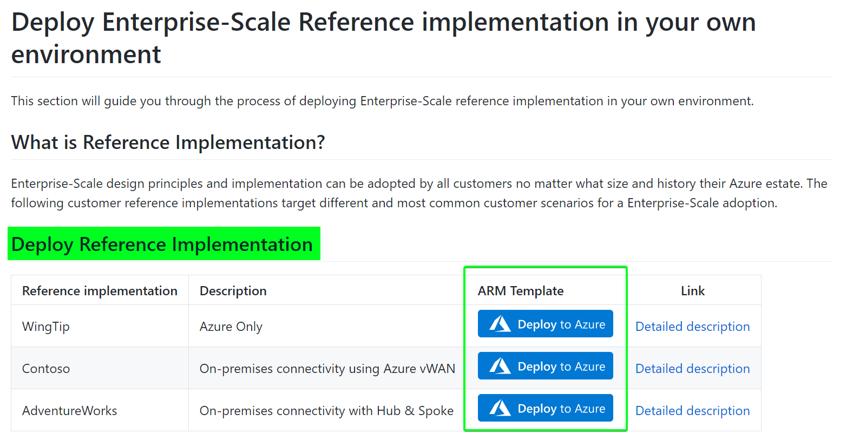
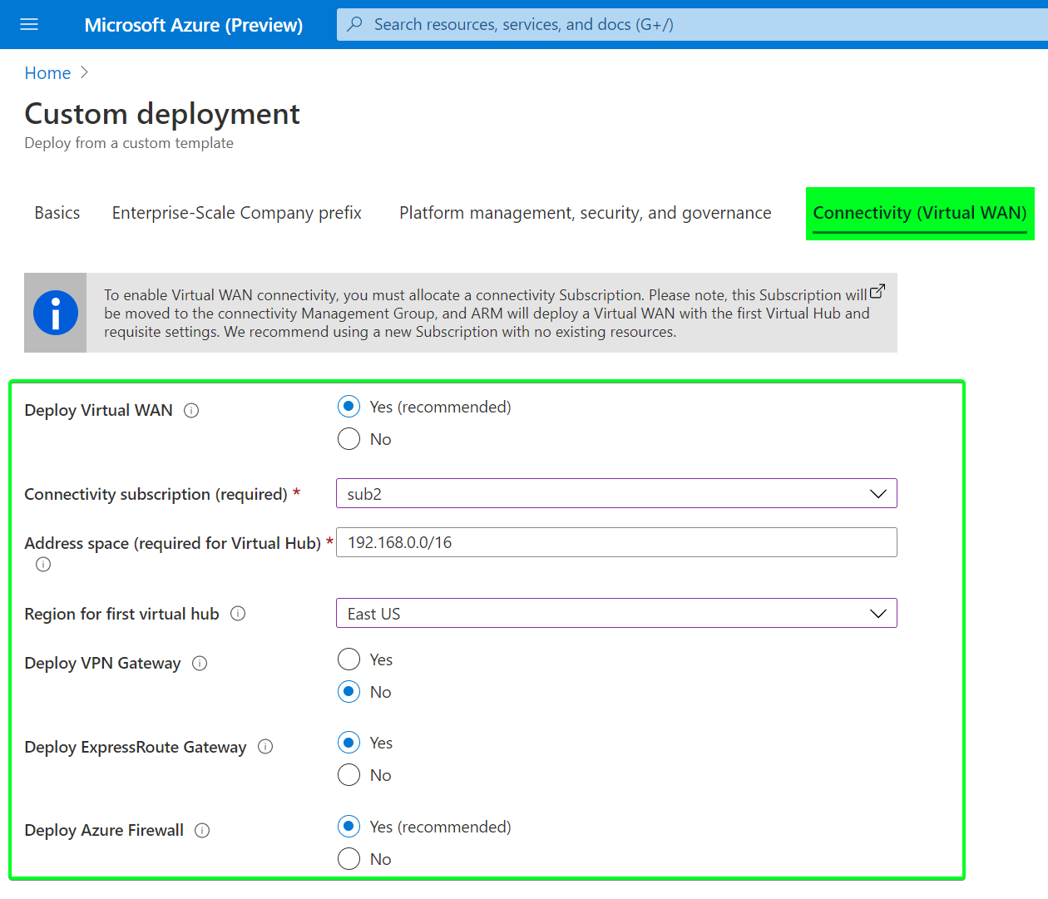
Getting Started: Enterprise scale
Call to Action:
Review the Enterprise-scale landing zones Architecture guidance
Review the Enterprise-scale landing zones implementation guidelines
Review and deploy a reference implementation:
Notes:
On June 15, we release ES in the CAF
Enterprise-scale Architecture in the CAF under Ready
3 Reference Implementations with a Portal based deployment experience using ARM Templates on GitHub
Call to action. Getting started with Enterprise Scale
Our goal to help you build a successful foundation in Azure for application and workloads. We have a few key resources as additional take aways in the presentation deck.
Thanks you!

Slide 27
Demo Getting started with Azure landing zones
Rob Kuehfus

Slide 28
Considerations to choose the best landing zone options
Initial considerations | Start small and expand | Enterprise-scale
Operating model alignment | Centralized Operations | Enterprise Operations
Provides a baseline architecture/environment | Simple starting point to build your own solution with minimal subscriptions (scale only as needed) | Yes, for the entire Azure tenant regardless of customer’s scale-point, includes cloud-native operations
Adoption plan considerations | Start small and expand | Enterprise-scale
Provides long-term self-sufficiency | Requires CAF Govern and Manage methodologies to achieve long-term self-sufficiency. See trigger for ESLZ consideration. | Yes, enterprise-scale architecture -> 1:N landing zones Approach & architecture prepare the customer for long-term self-sufficiency, the RIs are there to get you started
Enables adoption velocity across the organization | Quickly enable low risk adoption. Build towards security, governance, compliance. | Start with security, governance, compliance to enable compliant adoption sooner.
Achieves operational excellence | Requires CAF Govern and Manage methodologies to achieve operational excellence | Yes. Enables autonomy for platform and application teams with a policy driven governance and management
Compliance considerations | Start small and expand | Enterprise-scale
Path to reach security, governance, and compliance | Iterative approach. Requires Govern and Manage methodologies to support sensitive data or mission critical workloads. | 1:N landing zones & enterprise-scale architecture includes designs for segmentation and separation of duty to empower teams to act within appropriate landing zones
Risks while building out security, governance, and compliance | There is a risk of extensive refactoring or even redeployment to deliver on those needs. | There is a risk of enabling cloud-native operations products that may not align to your operating model.
Deployment considerations | Start small and expand | Enterprise-scale
Best-practices from cloud provider | Yes, Additional best practices added using CAF methodologies to apply security, governance, compliance | Yes
All critical services are present and properly configured according to recommend best practices for identity & access management, governance, security, network and logging | Partial. Some resources are deployed. Additional offerings aligned to CAF methodologies required to apply best practices to support security, governance, & compliance. | Yes, using a multi-subscription design, aligned with Azure platform roadmap
Automation capabilities (IaC/DevOps) | Yes: ARM, Policy, Blueprint Could create your own CICD pipeline | Yes: ARM, Policy, GitHub/AzureDevOps CICD pipeline option include
Timeline considerations | Start small and expand | Enterprise-scale
Timeline to adopt or migrate a low risk workload | 3-10 days | 3-10 days (WingTip RI)
Timelines to reach security, governance, and compliance requirements for all workloads | 4-6 months | 6-8 weeks

Slide 29
Key customer landing zone requirements | Start small and expand Migration landing zone | Enterprise-scale Architecture Reference Implementation
Operating model alignment | Centralized Operations | Enterprise Operations
Timelines to reach security and compliance requirements for a workload | 4-6 months | 6-8 weeks
Provides a baseline architecture/environment | Simple starting point to build your own solution with minimal subscriptions (scale only as needed) | Yes, for the entire Azure tenant regardless of customer’s scale-point, includes cloud-native operations
Best-practices from cloud provider | Yes, Additional best practices added using CAF methodologies to apply security, governance, compliance | Yes
Be aligned with cloud provider’s platform roadmap | Yes | Yes
UI Experience | Yes, Azure Portal | Yes, Azure Portal
All critical services are present and properly configured according to recommend best practices for identity & access management, governance, security, network and logging | Partial. Some resources are deployed. Additional offerings aligned to CAF methodologies required to apply best practices to support security, governance, & compliance. | Yes, using a multi-subscription design, aligned with Azure platform roadmap
Automation capabilities (IaC/DevOps) | Yes: ARM, Policy, Blueprint Could create your own CICD pipeline | Yes: ARM, Policy, GitHub/AzureDevOps CICD pipeline option include
Provides long-term self-sufficiency | Requires CAF Govern and Manage methodologies to achieve long-term self-sufficiency. See trigger for ESLZ consideration. | Yes, enterprise-scale architecture -> 1:N landing zones Approach & architecture prepare the customer for long-term self-sufficiency, the RIs are there to get you started
Enables migration velocity across the organization | Depends. Requires CAF Govern and Manage methodologies to support sensitive data or mission critical workloads. There is a risk of extensive refactoring or even redeployment to deliver on those needs. | Yes, enterprise-scale architecture -> 1:N landing zones, Architecture includes designs for segmentation and separation of duty to empower teams to act within appropriate landing zones
Achieves operational excellence | Requires CAF Govern and Manage methodologies to achieve operational excellence | Yes. Enables autonomy for platform and application teams with a policy driven governance and management

Slide 30
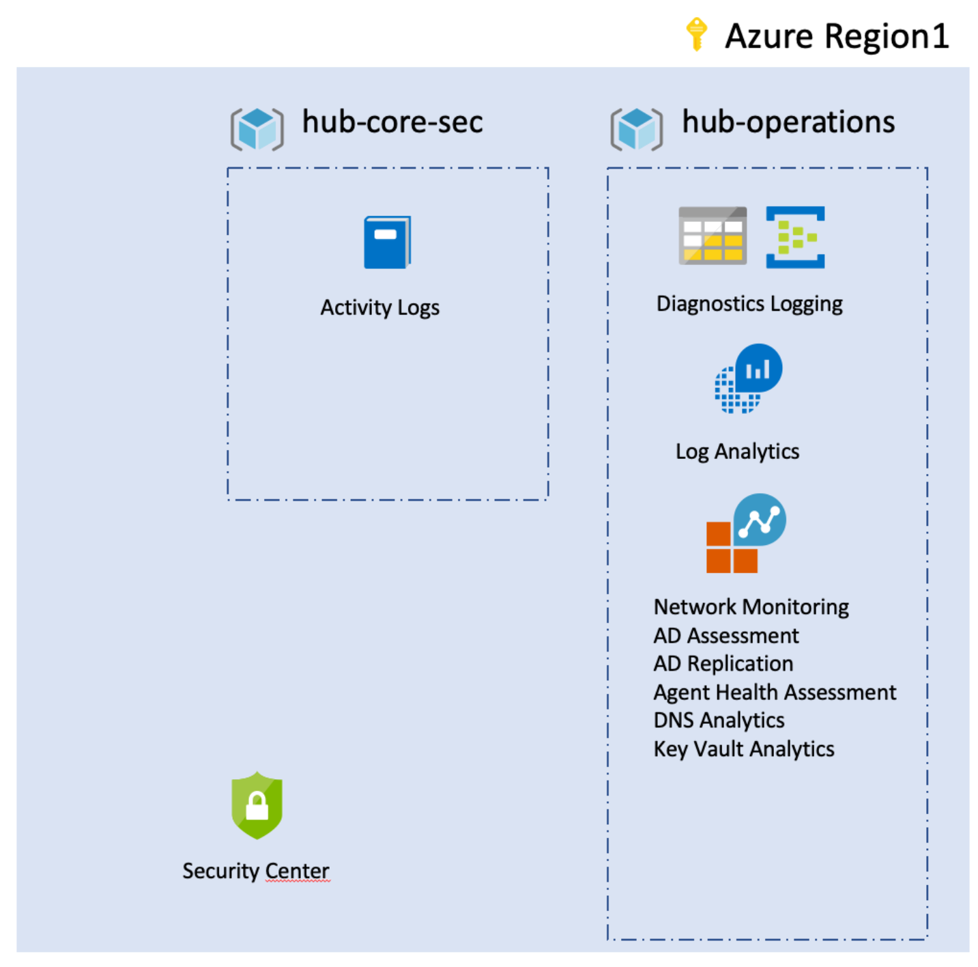
Implementation options – Third-party & Partner options
→ Partner landing zones
→ CAF Terraform modules
Validate a partner offer
Understand partners approaches and solution
Validate cloud operating model
Review partners solution for governance, security, and compliance
Review partners design, based on design areas
Deployment options for partner landing zone
Build on existing terraform skills
Path for multicloud operating models
Design Azure landing zones, based on design areas
Enable the community with a set of sample reusable landing zones
Deploy workloads to Azure
Notes:
The Cloud Adoption Framework approaches cloud adoption as a self-service activity. The objective is to empower each team that supports adoption through standardized approaches. In reality, you can't assume that a self-service approach is sufficient for all adoption activities.
Successful cloud adoption programs typically involve at least one level of third-party support.
Many cloud adoption efforts require support from a systems integrator (SI) or consulting partner who provides services that accelerate cloud adoption. Managed service providers (MSPs) provide enduring value by supporting landing zones and cloud adoption, but they also provide post-adoption operations management support. Additionally, successful cloud adoption efforts tend to engage one or more independent software vendors (ISV) who provide software-based services that accelerate cloud adoption. The rich partner ecosystems of SIs, ISVs, MSPs, and other forms of Microsoft partners have aligned their offerings to specific methodologies found in the Cloud Adoption Framework. When a partner is aligned to the Ready methodology of this framework, they will likely offer their own Azure landing zone implementation option.

Slide 31
Partner landing zone considerations
Are you aligned to the Ready methodology?
Expert MSPs – audited to validate ability to delivery CAF
Do you support both approaches?
Start small and expand
Start with enterprise scale (new)
Are you aligned to the design principles?
What deployment options do you support?
Configuration automation
Manual configuration
Does your Azure landing zone align across the 8 areas of design?
What are the incompatibilities?
What are your unique differentiators?

Slide 32
Resources

Slide 33
Deploy cloud-ready environments
Read the Documentation
Microsoft Cloud Adoption Framework for Azure
https://aka.ms/adopt/overview
Learn about Azure Landing Zones
Azure Landing Zones
https://aka.ms/adopt/landingzones
Implement Enterprise-scale Landing Zones in Azure
Examples and GitHub resources for implementation
https://aka.ms/adopt/landingzones/enterprise-scale/implementation
Find partners to support Azure Landing Zone Implementation
Partners with Azure landing zone options
https://aka.ms/adopt/findapartner/ready
Notes:
<Key point>:What resources are available to guide you in designing and building your solution offerings? Here are some next steps:
<Talking Points>
<Transition>: Thank you

